Slide 1
Mastering Distributed System Design
Attributes of Distributed Systems
Notes:
So, we understand the what and the why of system design. We know we're focusing on High-Level Design for distributed systems.
But this raises a critical question: What makes a distributed system good? What are the actual goals we are designing for?
In a single, simple application, success might be 'it works.' But in a distributed world, 'working' isn't enough. The system must work when millions of users hit it at once. It must work when a critical server catches fire. It must work for a user halfway across the globe. And it must continue to work as our team constantly changes and improves it.
These aren't nice-to-haves. They are the non-functional requirements that become our primary design drivers. They are the qualities we measure, argue about, and optimize for in every architecture meeting.
To design effectively, we need a shared vocabulary for these qualities. We need to define what we mean by a system that is robust, fast, and future-proof.
This brings us to the core Attributes of Distributed Systems. Think of these not as a checklist, but as a framework for thought—a set of interconnected, and sometimes competing, goals that will guide every single decision we make from here on out.

Slide 2
Attributes
Communication (The fundamental challenge: how components talk)
Consistency (Everyone sees the same data at the same time)
Availability (Can you get a response, even if it's stale?)
Reliability (Does the system behave correctly over time?)
Fault Tolerance (How it achieves reliability despite failures)
Scalability (How it handles increased load)
Durability (The guarantee that your data must persist and not be lost)
Maintainability (How we manage the system's evolution)

Slide 3
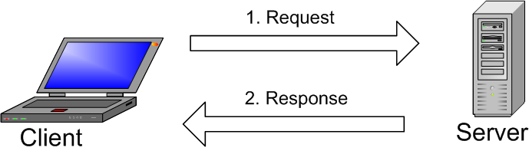
Communication
Communication is the first, foundational challenge of distributed systems.
All interaction happens over a network—an imperfect & unreliable medium.
Example: A web browser sending an HTTP request to a server.
Notes:
Let's begin with the first and most fundamental challenge in any distributed system: communication.
Every distributed system is, at its heart, a group of nodes—servers, services, devices—that need to talk to each other. And they do this over a network, which is not a perfect, reliable pipe. It's a complex, sometimes chaotic, shared medium.
Think of a simple web request. Your browser takes a URL, finds the server's address, and sends an HTTP request. The server processes it and sends back a response with the webpage. This seems straightforward, but a lot can go wrong between that request and response.
This forces us to ask some critical design questions:
First, representation: How are these messages—the request and the response—actually encoded into bits and bytes on the network wire?
Second, reliability: What happens during a temporary network blip, or if a faulty router corrupts part of our message? How does our system detect and recover from that?
Third, security: How do we guarantee that no one in the middle can eavesdrop on or tamper with this conversation?
Now, you might think, 'This is what my networking library handles for me.' And that's true to an extent. Libraries provide crucial abstractions.
But here's the key insight for system designers: abstractions leak. When a network partition happens or a strange timeout occurs, that underlying complexity bubbles up to your application layer. To debug it, to design for it, and to choose the right protocols and libraries, you need a solid understanding of how the network stack actually works.
So, communication isn't just about calling an API. It's about understanding the fragile, uncertain path your data takes and building your system's logic to survive the journey.

Slide 4
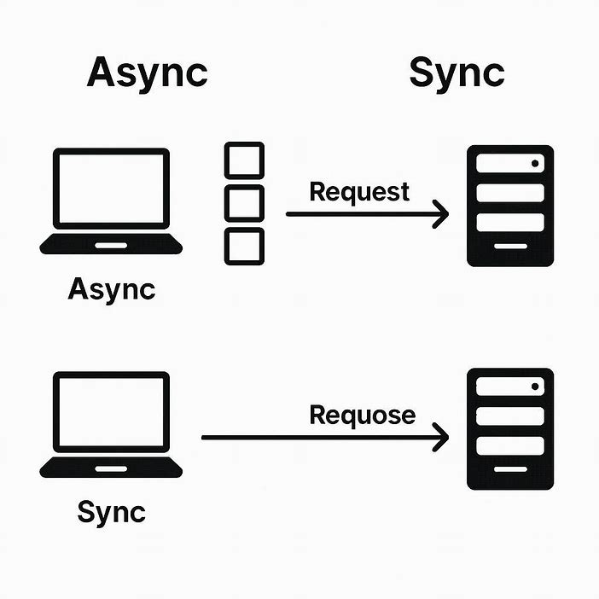
Communication Types
Synchronous: Sender waits for a response (like HTTP).
Asynchronous: Sender sends a message and moves on (like messaging queues).
Notes:
Now, a key design choice we must make is how components communicate. We have two fundamental patterns:
Synchronous communication, like the HTTP call I just described, where the sender waits—blocks—until it gets a response. It's direct and simple, but fragile: if the server is slow or down, the caller is stuck waiting.
Asynchronous communication, where a service sends a message—say, to a queue—and immediately continues its work. Another service picks up that message later and processes it. This decouples the components, making the system more resilient, but it adds complexity in tracking and guaranteeing message delivery.
Now, you might think, 'This is what my networking library handles for me.' And that's true to an extent. Libraries provide crucial abstractions for both synchronous and async patterns.

Slide 5

Coordination
Coordination is how nodes make collective decisions and maintain consistent state.
It's essential for Reliability (correct behavior) but often conflicts with Scalability.
Notes:
Beyond just communicating, distributed systems face a second, even trickier challenge: coordination.
While communication is about exchanging messages, coordination is about agreeing on what those messages mean and making collective decisions. This is the mechanism that allows a distributed system to act as one coherent unit rather than a collection of independent parts.
Why is coordination so critical? Because it directly enables Reliability—the system working correctly over time. Without coordination, nodes might make conflicting decisions, corrupt data, or create inconsistent states. Think about a distributed database: if two nodes try to update the same record simultaneously without coordinating, you get data corruption.
But here's the crucial tension: coordination often comes at the cost of Scalability. The more nodes need to coordinate, the more they need to communicate and wait for each other, creating bottlenecks. This is why you'll hear about the CAP theorem later—you often have to choose between strong Consistency (requiring coordination) and Availability/Scalability.
To understand why, let’s look at a famous thought experiment: The Two Generals Problem.
Imagine two armies, each led by a general, positioned on two hills overlooking a city. To succeed, they must attack at the exact same time. The only way to coordinate is by sending messengers through the valley between them—and any messenger can be captured by the enemy.
So, General 1 sends a messenger: 'Let’s attack at dawn.' But did the message get through? General 1 doesn’t know. To be sure, General 2 could send a confirmation: 'Got it, dawn it is.' But now, did that confirmation arrive? General 2 doesn’t know. You see the trap: every acknowledgment itself needs an acknowledgment.
No matter how many rounds of confirmation you add, you can never achieve absolute certainty that both generals will attack together. This isn’t just a story—it’s a mathematical proof that perfect coordination over an unreliable network is impossible.
This reveals the profound difficulty of coordination in real systems. It’s why we need sophisticated algorithms—like consensus protocols—to reach practical, if not perfect, agreement.
Because this topic is so foundational, the entire second part of this book is dedicated to the distributed algorithms that make coordination possible in the imperfect world we build in.

Slide 6

Consistency
Definition: The guarantee that all users see the same data at the same time.
Core Problem: Data is replicated across multiple nodes for reliability and performance.
The Challenge: How do we keep all copies synchronized when updates occur?
The Goal: Make the distributed system behave like a single source of truth.
Real-World Example: Your bank balance must be consistent across all ATMs, apps, and branches.
Notes:
After communication and coordination, we come to one of the most discussed attributes: Consistency.
In simple terms, consistency is the promise that everyone sees the same thing at the same time. Imagine you and a friend are both looking at the same social media post on your phones. If you refresh and see 10 likes, but your friend sees 11, that's an inconsistency. For a social post, maybe that's okay. But for your bank account balance? That inconsistency is completely unacceptable.
So, we define consistency as the guarantee that data is uniform and accurate across all parts of a distributed system. The goal is to make a system with many copies of data behave as if there's just one single source of truth.
Why is this so hard? Because in a distributed system, we replicate data across different servers for reliability and speed. When an update happens—say, you add a 'like'—the system must now update all those copies. Doing this instantly and perfectly requires a lot of coordination and communication, which we just learned is difficult and slow.
But achieving this perfect consistency comes with trade-offs that force us to make design choices. This brings us to the different types of consistency models we can implement.

Slide 7
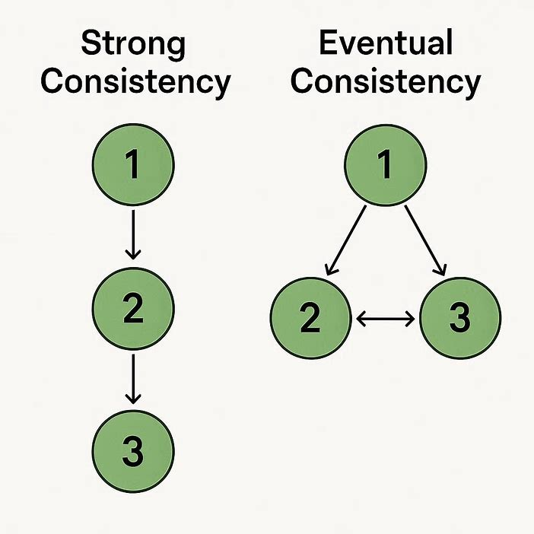
Consistency Models
Strong Consistency
All nodes see the latest write immediately.
The system acts like a single, up-to-date copy.
Can be slower and may reduce availability during failures.
Eventual Consistency
Given no new updates, all nodes will eventually see the same value.
Temporary inconsistencies are allowed; they resolve over time.
Higher availability and better performance.
Notes:
Because perfect consistency is so costly, we've developed different consistency models that let us make intelligent trade-offs based on our application's needs.
This leads to the fundamental trade-off. Strong Consistency—where every user always sees the latest data—can make the system feel slower or even become unavailable if a node fails. Sometimes, we consciously choose weaker Consistency for the sake of better availability and speed, accepting that users might briefly see stale data.
Think of it this way:
Your bank account requires strong consistency. Every transaction must be instantly reflected everywhere.
A social media 'like' counter can often use weaker consistency. It's acceptable if the number is slightly off for a second.
Getting this trade-off right is at the heart of designing data systems.
On one end, we have Strong Consistency. This is the strictest model. Here, the system guarantees that any read operation will return the most recent write. It makes the entire distributed database feel like a single, up-to-date server. This is non-negotiable for systems like banking or stock trading. The cost? It can be slower, as the system must coordinate to update all copies before confirming a write, and it might become unavailable if parts of the system fail.
On the other end, we have Eventual Consistency. This model prioritizes availability and speed. It allows different nodes to have slightly different data for a short period. The guarantee is simple: if you stop making updates, eventually all nodes will settle on the same value. This is perfectly acceptable for features like social media likes, comments, or a non-critical product catalog. You get a faster, more resilient system in exchange for temporary inconsistency.

Slide 8
Availability
A measure of whether a system is operational and able to respond to requests.
The system can respond to requests (even if with degraded performance).
Availability (%) = [(Total Time - Total Downtime) / Total Time] × 100
Notes:
Let's talk about Availability - one of the most user-visible attributes of any system.
At its core, availability is about accessibility. It answers the question: 'Can users reach and use the service right now?' When you click on an app icon, availability determines whether you get a working interface or an error message.
Think of it like a store's opening hours. A 24/7 convenience store has near-perfect availability - you can almost always get in. A bank with 9-to-5 hours has lower availability - there are times when you simply cannot access the service.

Slide 9
Measuring Availability
Availability % | "Nines" | Downtime per Year | Downtime per Month
99% | Two Nines | 3.65 days | 7.3 hours
99.9% | Three Nines | 8.76 hours | 43.8 minutes
99.99% | Four Nines | 52.6 minutes | 4.38 minutes
99.999% | Five Nines | 5.26 minutes | 25.9 seconds
99.9999% | Six Nines | 31.5 seconds | 2.59 seconds
99.99999% | Seven Nines | 3.15 seconds | 0.26 seconds
Notes:
In distributed systems, we measure availability in 'Nines' - and each additional nine represents a quantum leap in reliability engineering.
Look at this table. 99% availability - that's 'two nines' - sounds pretty good, right? But it means 3.65 DAYS of downtime per year. For most online businesses today, that's completely unacceptable.
Now look at 99.99% - 'four nines'. That's just 52 minutes of downtime per year. And 99.999% - 'five nines' - is only 5 minutes per year.
This progression isn't linear - it's exponential. Going from 99% to 99.9% means reducing downtime from 87.6 hours to 8.76 hours per year. That's a 90% improvement with just one additional nine.
But here's the catch: each additional nine typically costs 10 times more to achieve. The infrastructure, redundancy, monitoring, and engineering effort required for five nines versus three nines is enormous.
Most consumer web services aim for three to four nines. Mission-critical systems like financial exchanges or emergency services might target five nines. Very few systems truly achieve six or seven nines - we're talking about seconds of downtime per year.

Slide 10
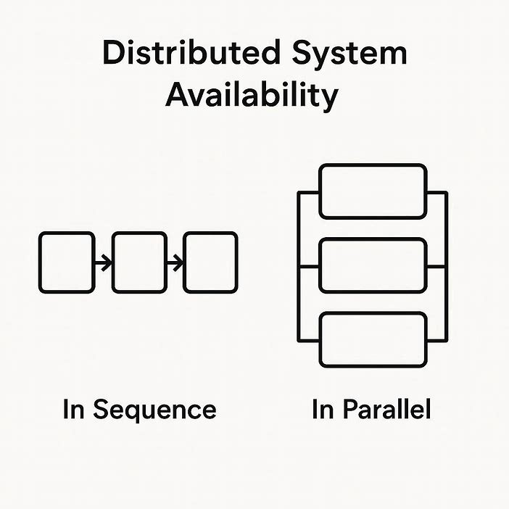
Availability in Sequence vs Parallel
A_series = A1 × A2 × A3 × ... × An
Example: 0.99 × 0.99 × 0.99 = 0.97 (97%)
Parallel Availability = 1 - [(1 - A₁) × (1 - A₂) × ... × (1 - Aₙ)]
Example = 1 - [(1 - 0.99) × (1 - 0.99)] = 1 - [0.01 × 0.01] = 1 - 0.0001 = 0.9999 = 99.99%
Notes:
Now let's understand how system architecture affects availability. Consider two fundamental arrangements: Sequence and Parallel.
In a sequence system, components are chained together like links in a chain. The user's request must pass through every component successfully. Think: web server → application server → database. If any one fails, the whole system fails.
The math here is brutal: You MULTIPLY the availabilities. If you have three components, each with 99% availability (0.99), your overall system availability is 0.99 × 0.99 × 0.99 = 0.97, or 97%. Three components reduced your system's availability!
"In a parallel system, components are redundant. The system works if ANY of the components work. Think: multiple web servers behind a load balancer. If one fails, others handle the traffic.
The math here is much friendlier: Availability = 1 - (probability ALL fail). With two components each at 99%, the probability both fail is 0.01 × 0.01 = 0.0001. So system availability is 1 - 0.0001 = 0.9999, or 99.99%!
This is why we build redundancy into critical paths. We transform series dependencies into parallel ones wherever possible. Load balancers with multiple servers, database replicas, multiple network providers - these all create parallel paths that dramatically boost availability.

Slide 11
Availability Patterns
Failover
Replication
Circuit Breaker
Retry with Backoff

Slide 12
Understanding Failover
The automatic process of switching to a standby system when the primary system fails
Notes:
Before diving into specific patterns, let's understand the fundamental concept of Failover.
Failover is the automatic process of switching to a backup or standby system when the primary system fails. The goal is simple: keep the service running even when individual components fail.
Think of it like a spare tire in your car. When your main tire gets a flat, you don't abandon the car - you switch to the spare and continue driving. In systems, when our primary server fails, we automatically switch to a standby server so users can continue using the service.
The process has four key steps: First, continuous monitoring - we're constantly checking if the primary system is healthy. Second, failure detection - we identify when something is wrong. Third, automatic switchover - we redirect traffic to the standby system. Fourth, recovery - we can fix the primary and bring it back online.
This automatic detection and switching is what distinguishes failover from manual recovery. Without failover, every failure requires human intervention, causing longer outages.
Failover addresses one of our core availability principles: eliminating single points of failure. If one component can take down your entire service, you need failover."

Slide 13
Types of Failover
System-Level Failover - Entire server or VM fails over
Service-Level Failover - Specific service fails over
Component-Level Failover - Specific component fails over
Notes:
Failover comes in different flavors depending on what's failing over and how.
First, by scope: We have system-level failover where an entire server or virtual machine moves to backup hardware. This is common in virtualization platforms. Then service-level failover where just a specific service - like our database - moves to another node while other services stay put. And component-level failover for individual hardware pieces like network cards or storage arrays.
Second, by timing: Automatic failover happens immediately when failure is detected - no human needed. Manual failover requires an administrator to initiate the switch. Semi-automatic is a hybrid - the system detects the failure and suggests failover, but a human confirms.
Third, by direction: Unidirectional failover goes one way - from primary to backup. Bidirectional means we can fail back to the original once it's repaired.
The choice depends on your requirements: How fast must recovery be? How critical is the service? What resources are available for monitoring and automation?

Slide 14
Failover Flavors: Active-Passive vs Active-Active
Active-Passive
Primary: 🟢 ACTIVE (handling 100% traffic)
Secondary: 🔵 STANDBY (idle, ready)
Arrow: Traffic → Primary only
Failure: Switch to Standby
Active-Active
Server A: 🟢 ACTIVE (handling 50% traffic)
Server B: 🟢 ACTIVE (handling 50% traffic)
Load Balancer: Distributes traffic
Failure: Redistribute to remaining servers
Notes:
Now that we understand failover basics, let's examine the two fundamental architectures: Active-Passive and Active-Active.
Think of them like a sports team. In Active-Passive, you have a starting player and a substitute on the bench. The starter plays the whole game unless injured, then the substitute jumps in. One is active, one is passive.
In Active-Active, you have multiple players on the court simultaneously, all contributing. If one gets tired or injured, the others cover and take on more load. All are active.
Both achieve failover but with different approaches and trade-offs. Let's explore each in detail.

Slide 15
Active-Passive vs Active-Active Comparison
Aspect | Active-Passive | Active-Active
Resource Usage | Wastes standby capacity | 100% utilization
Failover Speed | Seconds to minutes | Instantaneous
Complexity | Lower | Higher (state management)
Scalability | Vertical scale only | Horizontal scaling
Cost Efficiency | Lower (idle resources) | Higher
Best For | Stateful systems, databases | Stateless services, web apps
Data Consistency | Easier to maintain | More challenging
Notes:
How do you choose between these patterns? Let's compare them head-to-head.
Active-Passive is simpler to implement, especially for stateful systems like databases. It's easier to maintain data consistency since only one node writes at a time. But you pay for resources that sit idle, and failover takes time for the standby to 'wake up’.
Active-Active uses resources efficiently - every server contributes. Failover is instant since other servers are already running. It enables horizontal scaling - just add more servers. But it's more complex: you need to manage shared state, session persistence, and data synchronization.
For stateful systems (databases, file servers), Active-Passive is often preferred because managing concurrent writes to the same data is complex.
For stateless services (web servers, APIs, microservices), Active-Active is ideal because any server can handle any request.
Many organizations use both: Active-Active for the stateless web tier, Active-Passive for the stateful database tier.

Slide 16
Replication
The automatic process of switching to a standby system when the primary system fails

Slide 17
Synchronous vs Asynchronous Replication
Wait for all replicas acknowledge success
Guarantee: All replicas have same data
Latency: Higher (must wait for replicas)
Durability: Excellent (multiple copies confirmed)
Availability: Lower (all replicas must be available)
Acknowledge immediately and replicate later
Guarantee: Eventual consistency
Latency: Lower (acknowledge immediately)
Durability: Risk of data loss if primary fails
Availability: Higher (replica failure doesn't block writes)
Notes:
Replication strategies primarily differ in their synchronization method: Synchronous vs Asynchronous.
Synchronous Replication means: when you write data, the primary waits until all replicas confirm they've received it before acknowledging success to the client. This guarantees all copies are identical. Great for consistency! But it adds latency (must wait for slowest replica) and reduces availability (if any replica is down, writes fail).
Asynchronous Replication means: the primary acknowledges writes immediately, then replicates to replicas in the background. This gives better performance and availability (writes succeed even if replicas are down). But there's risk: if the primary fails before replicating, that data is lost. And replicas might have stale data.
This is a classic trade-off: strong consistency (synchronous) vs high performance and availability (asynchronous). Financial systems often choose synchronous for data integrity. Social media might choose asynchronous for better user experience.

Slide 18
Common Replication Topologies
Single Leader (Master-Slave)
One write node, many read replicas
Multi-Leader (Master-Master)
All accept writes, sync with each other
Leaderless (Peer-to-Peer)
All nodes equal, Write to N nodes, read from N nodes
Gossip protocol for synchronization
Notes:
Different replication topologies suit different needs:
Single Leader (also called Master-Slave): One node handles all writes, multiple nodes handle reads. This is simple and maintains write consistency. But the leader is a single point of failure for writes. MySQL, PostgreSQL often use this.
Multi-Leader: Multiple nodes can accept writes, they synchronize with each other. This improves write availability - users in different regions can write to local leaders. But now we need conflict resolution: what if two leaders modify the same data? Systems must detect and resolve these conflicts.
Leaderless (Peer-to-Peer): All nodes are equal. When writing, you write to N nodes. When reading, you read from N nodes and reconcile versions. Cassandra and DynamoDB use this. It offers maximum availability and partition tolerance but is eventually consistent.
The choice depends on your requirements: How critical is write consistency? How important is write availability? How will you handle conflicts?

Slide 19
Circuit Breaker
CLOSED: ✅ Normal operation (requests flow through)
OPEN: 🔴 Circuit broken (fail fast, no requests)
HALF-OPEN: 🟡 Testing recovery (limited requests)
Notes:
Now let's look at a critical pattern for preventing system-wide failures: the Circuit Breaker.
This pattern takes its name from electrical systems. Just as an electrical circuit breaker trips when there's too much current, preventing fires, our software circuit breaker trips when a service dependency is failing too often, preventing cascade failures.
The circuit has three states: CLOSED - normal operation, requests flow to the service. OPEN - the circuit is broken. Instead of calling the failing service and timing out, we immediately return an error or fallback response. This is failing fast. HALF-OPEN - after a timeout period, we allow limited test requests through to see if the service has recovered.
Here's why this matters: Without a circuit breaker, if Service A calls Service B which is failing, Service A waits... and waits... and eventually times out. Meanwhile, Service A's resources are tied up, it can't serve other requests, and it might fail too. This cascade can take down your entire application.
The circuit breaker breaks this chain. It says: 'Service B is failing, stop calling it, fail fast instead.' This gives Service B time to recover without being bombarded by retry attempts.

Slide 20
Retry with Backoff
Retry transient failures
Should I retry?
├── Is it a transient failure? (Timeout, 503) → YES → Retry
├── Is it a permanent failure? (404, 400) → NO → Don't retry
├── Have I exceeded max retries? → NO → Calculate delay
└── Should I use fallback? → YES → Return cached/default value
Notes:
Complementing the circuit breaker is the Retry with Backoff pattern.
Transient failures happen: a network hiccup, a brief overload, a garbage collection pause. Retrying can often succeed. But naive retries make things worse.
Imagine 1000 clients all experiencing a timeout. If they all retry immediately, they create a thundering herd that overwhelms the already struggling service.
Smart retrying adds delays between attempts. The most common strategy is Exponential Backoff: wait 1 second, then 2, then 4, then 8. Each failed attempt waits twice as long.
Jitter adds randomness: wait 1.3 seconds, not exactly 1.0. This prevents synchronized retries from many clients.
Critical rule: Only retry transient failures - timeouts, connection errors, 503 Service Unavailable. Don't retry permanent failures like 404 Not Found or validation errors - they'll never succeed on retry.
And ensure operations are idempotent - safe to retry. Adding $10 to an account twice shouldn't add $20.
DO retry transient failures: network timeouts, connection errors, HTTP 503 Service Unavailable, HTTP 429 Too Many Requests. These are often temporary.
DON'T retry permanent failures: HTTP 404 Not Found, 400 Bad Request, 403 Forbidden. If the request is invalid or unauthorized, retrying won't help.
Critical rule #1: Only retry idempotent operations. GET requests are safe to retry. PUT and DELETE can be idempotent if they always produce the same result. But POST requests that create resources? Retry those and you might create duplicates.
Critical rule #2: Set maximum retry limits. Usually 3-5 attempts is sufficient. Consider your overall timeout: if your service must respond in 2 seconds, don't set up retries that could take 10 seconds.
Critical rule #3: Use idempotency keys for non-idempotent operations. Include a unique ID with requests so the server can detect and ignore duplicates.

Slide 21
Reliability
Definition : The probability that a system will perform its intended function correctly over a specified period of time
System Unreliable: ✅ System Up but ❌Wrong Answers.
System Reliable: ✅ System Up and ✅Correct Answers.
Notes:
Now we come to a crucial distinction: Reliability versus Availability.
While availability asks 'Is the system reachable?', reliability asks 'Does it work correctly when you reach it?'
Think of a restaurant that's always open (high availability) but frequently gets orders wrong (low reliability). Or a restaurant that's sometimes closed (lower availability) but always perfect when open (high reliability).
Reliability is the probability that a system performs its intended function correctly over time. If you request data, do you get the right data? If you submit a transaction, does it process correctly?
Availability and reliability often go together, but they're different. A system can be:
Available but unreliable (responding with errors or wrong data)
Unavailable but reliable (when it does work, it works perfectly)
Ideally: Both available and reliable
The perfect system is both highly available AND highly reliable.

Slide 22
Measuring Reliability: MTBF and MTTR
MTBF (Mean Time Between Failures): Measures how long system runs before failing
MTBF = (Total elapsed time - sum of total time system was down)/ Total number of Failures
MTTR (Mean Time To Repair): Measures how long to recover from failure
MTTR= (Total maintenance times)/ Total number of Repairs
Notes:
To measure reliability quantitatively, we use two key metrics: MTBF and MTTR.
MTBF - Mean Time Between Failures: This tells us how long the system typically runs before failing. If MTBF is 1000 hours, the system fails about every 42 days on average. Higher MTBF means more reliable - failures are rare.
MTTR - Mean Time To Repair: This measures how quickly we recover from failures. If MTTR is 2 hours, it takes about 2 hours to fix things when they break. Lower MTTR means faster recovery.
Here's the crucial insight: Both metrics matter for availability. You can calculate availability from them: Availability = MTBF divided by (MTBF + MTTR).
A system with high MTBF (rare failures) but high MTTR (slow recovery) might have poor availability. A system with moderate MTBF but very low MTTR (quick recovery) can have excellent availability.
This is why we invest in both: preventing failures (increasing MTBF) and improving recovery (decreasing MTTR).
In practice, we measure reliability using several metrics:
First, Error Rate - what percentage of requests fail? If 999 out of 1000 requests succeed, that's 0.1% error rate, or 99.9% reliability. This is often tracked per API endpoint, per service.
Second, SLA/SLO Compliance - we set Service Level Objectives like "99.9% of requests must succeed" and measure if we're meeting them. We track this daily, weekly, monthly.
Third, Failure patterns - when do failures occur? During peak load? After deployments? At certain times of day? This helps us understand root causes.
Fourth, User impact - bug reports, support tickets, user satisfaction. The most important reliability metric is: are users getting what they need?
We often set different reliability targets for different operations. A login might need 99.99% reliability (users must be able to log in). A recommendation engine might accept 99% reliability (occasional wrong suggestions are okay).
The key is to measure what matters to users, not just what's easy to measure.

Slide 23
Fault Tolerance
Definition : A system's ability to continue operating properly when some of its components fail.
Goal: System handles abnormal conditions gracefully.
Notes:
Now we come to a critical capability: Fault Tolerance.
While reliability is about working correctly under normal conditions, fault tolerance is about continuing to work when things go wrong. It's the system's ability to survive failures without impacting users.
Let's clarify terms: A fault is a defect - a bug, a hardware problem, a network issue. A failure is when the system stops delivering its expected service. Fault tolerance is what prevents faults from becoming failures.
Think of an airplane with multiple engines. If one engine fails (a fault), the plane can still fly (no failure to passengers). Or your body with two kidneys - if one fails, you continue living.
The goal of fault tolerance is simple but ambitious: Make failures invisible to users. When a component fails, the system should automatically work around it, recover from it, or degrade gracefully - without users even noticing.

Slide 24
Fault Tolerance Techniques
Redundancy: 🔄 Multiple copies of critical components
Failover: 🔀 Automatic switching to backup
Checkpointing: 💾 Periodic state snapshots
Isolation: 🚧 Contain failures
Graceful Degradation: 📉 Reduce functionality, don't crash
Self-Healing: 🤖 Automatic recover
Notes:
So how do we actually build fault tolerance? Here are key techniques:
Redundancy is fundamental: have multiple copies of critical components. If one fails, others take over. This can be active-active (all working together) or active-passive (standbys ready).
Failover makes redundancy useful: automatic detection of failures and switching to backups. Health checks constantly monitor components, and when one fails, traffic is redirected.
Checkpointing - our new addition: Periodically save complete system state. Like save points in a video game. If something goes wrong, restart from the last good checkpoint rather than from scratch.
Isolation prevents cascade failures. The bulkhead pattern separates resources so failure in one area doesn't drain resources from others. Microservices architecture creates independent failure domains.
Graceful Degradation is crucial: when parts fail, reduce functionality rather than crash completely. Show cached data, default responses, or hide non-critical features.
Self-Healing automates recovery: automatically restart failed processes, replace failed nodes, or adjust system parameters. Modern platforms like Kubernetes excel at this.
These techniques work together. Redundancy without failover is useless. Failover without graceful degradation might switch to a system that can't handle the load. You need the full toolkit.

Slide 25
Recovery Objectives: RTO & RPO
RTO - Recovery Time Objective:
Definition: Maximum acceptable downtime duration after a failure
Measures: How long the system can be unavailable
Question: "How fast must we recover?"
Example: RTO = 4 hours = Must be back online within 4 hours
Drives: Recovery speed - automation, standby systems
RPO - Recovery Point Objective:
Definition: Maximum acceptable data loss duration
Measures: How much recent data can be lost
Question: "How much data can we afford to lose?"
Example: RPO = 1 hour = Can lose up to 1 hour of data
Drives: Backup frequency - how often to save state
Notes:
Now let's discuss how we measure the effectiveness of our fault tolerance: through RTO and RPO.
RTO - Recovery Time Objective measures downtime. If your RTO is 4 hours, you're saying "The system can be down for up to 4 hours after a failure." This drives how fast your recovery must be. Need 5-minute RTO? You need instant automated failover to hot standbys. OK with 8-hour RTO? Manual recovery processes might suffice.
RPO - Recovery Point Objective measures data loss. RPO of 1 hour means "Losing up to 1 hour of data is acceptable." This drives backup frequency. Want RPO of 0? You need synchronous replication - every write confirmed on backup before acknowledging to user. OK with 24-hour RPO? Daily backups might work.
These metrics directly connect to our fault tolerance techniques:
For low RTO (fast recovery), you need: Fast failover mechanisms, hot standby systems ready instantly, automated recovery procedures.
For low RPO (minimal data loss), you need: Frequent checkpoints, synchronous replication, continuous data protection.
The business decides what RTO/RPO they need based on cost of downtime and data loss. Technology delivers architecture to meet those targets. There's always a trade-off: better RTO/RPO means higher cost and complexity.

Slide 26
Scalability
Definition : A system's ability to handle increased load by adding resources
❌ Non-scalable: Single server crushed under heavy load
✅ Scalable: Multiple servers sharing load effortlessly
Notes:
Now we come to a crucial attribute for any growing system: Scalability.
Scalability is about handling growth gracefully. What happens when your user base grows 10x? When you get featured on Hacker News and traffic spikes? When you expand to new markets?
A scalable system can handle increased load by adding resources - servers, databases, network capacity. The goal isn't just to handle more load, but to maintain performance as load increases.
Think of a highway. A single-lane road handles limited traffic. Add more lanes, and you handle more cars. That's scalability.
Or a restaurant. A small cafe serves 50 customers. To serve 500, you need more tables, more kitchen staff, more everything. But ideally, you want to maintain the same quality and speed of service.
The fundamental challenge: Scaling without proper architecture is expensive and limited. You can't just keep buying bigger servers forever. Eventually, you need to change how the system works.

Slide 27
Scaling Dimensions: Vertical vs Horizontal
Vertical Scaling (Scale Up):
Approach: Make individual components bigger
Example: Upgrade server from 4GB RAM → 64GB RAM
Analogy: Getting a bigger truck to carry more cargo
Pros: Simple, no application changes needed
Cons: Single point of failure, expensive, limited ceiling
Best for: Monolithic applications, databases (initially)
Horizontal Scaling (Scale Out):
Approach: Add more components
Example: Add more web servers behind load balancer
Analogy: Using multiple trucks instead of one big truck
Pros: No single point of failure, cost-effective, near-infinite scale
Cons: Requires distributed architecture, more complex
Best for: Modern web applications, microservices
Notes:
There are two fundamental ways to scale: Vertical and Horizontal.
Vertical scaling (scale up) means making individual components bigger. Upgrade your server: more CPU, more RAM, faster disks. It's like getting a bigger truck to carry more cargo.
The advantage? Simple. Usually no application changes needed. The disadvantage? Expensive. Big servers cost disproportionately more. There's a physical limit. And you have a single point of failure.
Horizontal scaling (scale out) means adding more components. Instead of one big server, use ten smaller servers behind a load balancer. It's like using multiple trucks instead of one big truck.
The advantages: No single point of failure. Cost-effective - many small servers often cost less than one huge server. Near-infinite scale. The disadvantage: Requires distributed architecture, which is more complex.
Modern systems almost always choose horizontal scaling. The cloud makes it easy: just add more instances. But it requires designing your application to be stateless, to share nothing, to handle distributed data.

Slide 28
Durability
Definition : The guarantee that data, once written, will survive permanently
Core Promise: "Your data is safe, even if hardware fails"
Notes:
We now come to an attribute that's fundamental to trust: Durability.
Durability is the promise that data, once written, will survive permanently. It's not enough for data to be stored; it must be stored in a way that survives hardware failures, disasters, and the passage of time.
Think of ancient stone tablets versus chalk on a sidewalk. The stone carving lasts centuries; the chalk washes away in the rain. Or a safety deposit box versus carrying cash in your wallet.
Durability answers critical questions: What happens if a disk drive fails? What if a server catches fire? What if an entire data center goes offline? What about 10 years from now - will the data still be readable?
Important distinction: Durability is not the same as persistence. Persistence means data survives a process restart. Durability means it survives hardware failures, natural disasters, and long-term degradation. Durability is persistence taken to the extreme.

Slide 29
Why Durability Matters
Personal: Lost family photos, important documents
Business: Lost transactions, customer data, financial records
Critical: Medical records, legal documents, scientific research The 3-2-1 rule is a good starting point: 3 copies, on 2 different media types, with 1 copy offsite.
Notes:
Why does durability matter so much? Because lost data has real consequences.
For individuals, lost photos, documents, memories. For businesses, lost transactions mean lost revenue. Lost customer data means broken trust. For critical systems, lost medical records or legal documents can have life-altering impacts.
The business impact is severe: Financial loss from recovery efforts and lawsuits. Reputation damage - customers won't trust you with their data again. Legal consequences - GDPR fines can be 4% of global revenue. Operational disruption - you can't serve customers without their data.
But durability requirements vary. A social media post? Some loss might be acceptable. A bank transaction? Near-perfect durability required. A medical record? We aim for 100% durability.
The 3-2-1 rule is a good starting point: 3 copies, on 2 different media types, with 1 copy offsite.
The key insight: The cost of preventing data loss is usually far less than the cost of recovering from data loss. Investing in durability is insurance against catastrophic failure.

Slide 30
Achieving Durability: Techniques
Redundancy (Multiple Copies)
Geographic Distribution
Regular Backups
Data Integrity Checks
Versioning & Immutability
Notes:
So how do we achieve durability? Through multiple complementary techniques:
Redundancy is fundamental: store multiple copies. Simple replication keeps identical copies on different devices. Erasure coding is more sophisticated: split data into chunks with parity information. You can lose several chunks and still reconstruct the original. More space-efficient than simple replication.
Geographic distribution protects against regional disasters. Different data centers in different seismic zones, flood plains, power grids. Cloud providers offer availability zones and regions for this.
Regular backups are non-negotiable. Full backups, incremental backups, point-in-time recovery. Test your backups regularly - an untested backup is no backup at all.
Data integrity checks detect corruption. Checksums, CRCs, cryptographic hashes. When you read data, verify it hasn't been corrupted. Systems like ZFS do this automatically.
Versioning and immutability prevent accidental or malicious modification. Write-Once-Read-Many (WORM) storage, object versioning. If data can't be changed, it can't be corrupted.

Slide 31
Maintainability
Definition : The ease with which a system can be modified, updated, and improved over its lifecycle
❌ Hard to Maintain: Spaghetti code, tangled wires, "legacy system"
✅ Easy to Maintain: Clean architecture, modular components, clear documentation
Notes:
Our final critical attribute is Maintainability - how easily a system can be modified, updated, and improved throughout its lifecycle.
While other attributes focus on runtime behavior, maintainability focuses on the human aspect: how developers work with the system over time. Most systems live for years or decades, not weeks. They need to evolve.
Think of two cars: one where everything is accessible and standardized (easy to maintain), and another where you need to remove the engine to change a light bulb (hard to maintain).
There are three types of maintenance: Corrective - fixing bugs. Adaptive - adapting to new environments (new OS, new regulations). Perfective - adding features or improving performance.
The key insight: Most software cost comes from maintenance, not initial development. A system that's cheap to build but expensive to maintain is actually very costly over its lifetime. Maintainability is an economic concern as much as a technical one.

Slide 32
Performance
Definition:
Latency: Time taken for one operation to complete (e.g., 100ms for an API call)
Throughput: Number of operations completed in a time period (e.g., 1000 requests/second)
Bandwidth: Maximum data transfer rate of a channel (e.g., 1 Gbps network)
Notes:
Now we come to performance metrics that directly impact user experience: Latency, Throughput, and Bandwidth.
Latency is about time - how long does one operation take? When you click a button and wait for response, that's latency. We measure it in milliseconds. Good latency feels instantaneous; bad latency feels sluggish.
Throughput is about volume - how many operations can we handle per second? If 1,000 users click simultaneously, can we serve them all? Throughput measures our capacity.
Bandwidth is about data flow - how much data can move through a pipe? Network bandwidth, disk I/O bandwidth, memory bandwidth. It's the maximum data transfer rate.
Think of a highway: Latency is how long for one car to travel from city A to B. Throughput is how many cars pass a toll booth per hour. Bandwidth is how many lanes the highway has.
Crucially, these are independent but related. You can have high bandwidth (big pipe) but still have high latency (data takes long to travel). Or high throughput (many small requests) but each has high latency. Understanding this distinction is key to performance optimization.
A critical distinction: Throughput is not the same as Bandwidth.
Bandwidth is the maximum possible - your network card's 1 Gbps rating, your database's maximum I/O rate. It's a physical or design limit.
Throughput is the actual achieved - 500 requests/second, 10,000 database rows/second. It's what you actually get in practice.
Think highway lanes: Bandwidth is how many lanes exist. Throughput is how many cars actually pass per hour. Throughput can be less than bandwidth if there's an accident (bottleneck) or cars are slow (high latency).
A web server might have 1 Gbps bandwidth but only handle 500 requests/second because the CPU is the bottleneck, not the network.
There's a fundamental relationship: Throughput = Concurrency / Latency. If you have 10 concurrent requests and each takes 200ms, your throughput is 10 / 0.2 = 50 requests/second.
Little's Law from queuing theory formalizes this: Average requests in system = Throughput × Average Latency.
The key insight: Throughput is limited by your slowest component. Upgrade your 1 Gbps network to 10 Gbps, but if your database is the bottleneck, throughput won't improve. Find and fix the real bottleneck.

Slide 33
Performance Trade-offs
Attribute | Conflict with Performance | Example
Consistency | Strong consistency increases latency | Waiting for all replicas to confirm writes
Availability | High availability can reduce throughput | Maintaining redundant systems uses resources
Durability | Durable writes are slower | Writing to multiple disks/regions
Security | Encryption adds latency | TLS handshake, data encryption/decryption
Scalability | Scaling adds complexity that can hurt performance | Distributed transactions across shards
Maintainability | Clean abstractions can have overhead | Layered architecture, dependency injection
Notes:
Performance doesn't exist in isolation - it constantly trades off against other attributes.
Strong consistency hurts latency: waiting for all database replicas to confirm writes adds delay. Some systems accept eventual consistency for better performance.
High availability can reduce throughput: maintaining hot standbys uses resources that could serve requests.
Durability conflicts with speed: writing to multiple disks or regions is safer but slower. Some systems offer durability modes: 'write-through' (safe but slow) vs 'write-back' (fast but risky).
Security adds overhead: TLS encryption, authentication checks, audit logging all consume CPU and add latency.
Even within performance, there are trade-offs: Latency vs throughput - batching requests improves throughput but increases latency for individual requests. Read vs write optimization - indexes speed reads but slow writes.
The CAP theorem formalizes a key trade-off: during network partitions, choose Consistency (CP) or Availability (AP). CP systems have higher latency during partitions. AP systems respond quickly but might return stale data.
The reality: Every architectural decision involves trade-offs. Understand them, make intentional choices based on your requirements. Don't optimize blindly - optimize for what matters to your users and business.

